Slide 1

INFO 7225 Module 1
5. Cash-basis vs. Accrual-basis Accounting
Professor Shiaoming Shi
College of Engineering
Northeastern University

Slide 2
ACCRUAL ACCOUNTING

Slide 3
Learning objectives
After completing this session, you should be able to
Explain the difference between cash basis and accrual basis of accounting;
Apply revenue recognition principle and expense matching principle in accrual basis accounting;

Slide 4
GAAP Accounting Standards Connection Tree
Notes:
RefBook, Ch3.1
Figure 3.2 GAAP Accounting Standards Connection Tree.
Revenue Recognition Principle
The revenue recognition principle directs a company to recognize revenue in the period in which it is earned; revenue is not considered earned until a product or service has been provided. This means the period of time in which you performed the service or gave the customer the product is the period in which revenue is recognized.
There also does not have to be a correlation between when cash is collected and when revenue is recognized. A customer may not pay for the service on the day it was provided. Even though the customer has not yet paid cash, there is a reasonable expectation that the customer will pay in the future. Since the company has provided the service, it would recognize the revenue as earned, even though cash has yet to be collected.
For example, Lynn Sanders owns a small printing company, Printing Plus. She completed a print job for a customer on August 10. The customer did not pay cash for the service at that time and was billed for the service, paying at a later date. When should Lynn recognize the revenue, on August 10 or at the later payment date? Lynn should record revenue as earned on August 10. She provided the service to the customer, and there is a reasonable expectation that the customer will pay at the later date.
Cost Principle
The cost principle, also known as the historical cost principle, states that virtually everything the company owns or controls (assets) must be recorded at its value at the date of acquisition. For most assets, this value is easy to determine as it is the price agreed to when buying the asset from the vendor. There are some exceptions to this rule, but always apply the cost principle unless FASB has specifically stated that a different valuation method should be used in a given circumstance.
The primary exceptions to this historical cost treatment, at this time, are financial instruments, such as stocks and bonds, which might be recorded at their fair market value. This is called mark-to-market accounting or fair value accounting and is more advanced than the general basic concepts underlying the introduction to basic accounting concepts; therefore, it is addressed in more advanced accounting courses.
Once an asset is recorded on the books, the value of that asset must remain at its historical cost, even if its value in the market changes. For example, Lynn Sanders purchases a piece of equipment for $40,000. She believes this is a bargain and perceives the value to be more at $60,000 in the current market. Even though Lynn feels the equipment is worth $60,000, she may only record the cost she paid for the equipment of $40,000.

Slide 5
What is “revenue recognition principle”?
__________________
Directs a company to recognize revenue in the period in which it is earned; revenue is not considered earned until a product or service has been provided.
This means the period of time in which you performed the service or gave the customer the product is the period in which revenue is recognized.
No correlation between when cash is collected and when revenue is recognized.
GAAP Accounting Standards Connection Tree
What is “expense matching principle”?
__________________
States that we must match expenses with associated revenues in the period in which the revenues were earned.
Also referred to as the matching principle
Notes:
RefBook, Ch3.1
Figure 3.2 GAAP Accounting Standards Connection Tree.
Revenue Recognition Principle
The revenue recognition principle directs a company to recognize revenue in the period in which it is earned; revenue is not considered earned until a product or service has been provided. This means the period of time in which you performed the service or gave the customer the product is the period in which revenue is recognized.
There also does not have to be a correlation between when cash is collected and when revenue is recognized. A customer may not pay for the service on the day it was provided. Even though the customer has not yet paid cash, there is a reasonable expectation that the customer will pay in the future. Since the company has provided the service, it would recognize the revenue as earned, even though cash has yet to be collected.
For example, Lynn Sanders owns a small printing company, Printing Plus. She completed a print job for a customer on August 10. The customer did not pay cash for the service at that time and was billed for the service, paying at a later date. When should Lynn recognize the revenue, on August 10 or at the later payment date? Lynn should record revenue as earned on August 10. She provided the service to the customer, and there is a reasonable expectation that the customer will pay at the later date.
Expense Recognition (Matching) Principle
The expense recognition principle (also referred to as the matching principle) states that we must match expenses with associated revenues in the period in which the revenues were earned.
A mismatch in expenses and revenues could be an understated net income in one period with an overstated net income in another period. There would be no reliability in statements if expenses were recorded separately from the revenues generated.
For example, if Lynn earned printing revenue in April, then any associated expenses to the revenue generation (such as paying an employee) should be recorded on the same income statement. The employee worked for Lynn in April, helping her earn revenue in April, so Lynn must match the expense with the revenue by showing both on the April income statement.

Slide 6
Cash Accounting vs. Accrual Accounting
Cash basis of accounting
Revenue and expenses are recorded only based on if there is an exchange of cash.
Accrual basis of accounting
Revenues are recognized as soon as a product has been sold or a service has been performed, regardless of when the money is actually received.
All costs that match revenues reported in the present period are recorded as expenses, regardless of when the money is actually paid.

Slide 7
REVENUE RECOGNITION

Slide 8
Revenue Recognition Illustrated
Revenue recognition is the process of recording revenue in the accounting period in which it was _______.
This is not necessarily when cash is _________.
Most corporations assume that revenue has been earned at an objectively-determined point in the accounting cycle.
For instance, it is often convenient to recognize revenue at the point when a sales invoice has been sent to a customer and the related goods have been received by a customer or services performed.
\

Slide 9
GAAP Guidance on revenue Recognition
GAAP provide guidance about when an economic activity should be recognized in financial accounting and reporting.
An economic activity is recognized when it meets two criteria (whether payment has been received is not one of them):
It is probable that any future economic benefit associated with the item will flow to the business; and
It has a value that can be measured with reliability.
Notes:
Recognition Principle in More Detail
GAAP provide guidance about when an economic activity should be recognized in financial statements. An economic activity is recognized when it meets two criteria:
it is probable that any future economic benefit associated with the item will flow to the business; and
it has a value that can be measured with reliability.

Slide 10
accrual basis of accounting: introduction
Under the accrual accounting principle, a company could earn and report $1,000 of revenue in its first month of operation but receive $0 in actual cash in that month.
Example
ABC Consulting completes its service at an agreed price of $1,000.
ABC should recognize $1,000 of revenue as soon as its work is done.
It does not matter whether the client pays the $1,000 immediately or in 30 days.
Do not confuse revenue with a cash receipt.

Slide 11
Cash Accounting versus Accrual Accounting
ACE Corp.’s transactions in October
Service performed in October totaled $20,000. $18,000 cash payment was received in October; $2,000 will be received in November.
BEE Corp.’s transactions in October
Cash payment received in October totaled $20,000; $15,000 was for services that had be performed in October; $5,000 payment was for services that would be performed in November.
 | ACE Corp. | BEE Corp.
Revenue for Oct. (Cash Basis)
Revenue for Oct. (Accrual Basis)

Slide 12
Revenue Recognition Illustrated: Three POSSIBLE scenarios
Revenue was recognized _____ cash was received:
before
at the same time as, or
after

Slide 13
Revenue Recognition Illustrated (scenario 1)
A | L Eq - R | Ex
|
|
|
|
|
↑
↑
↑
↑
↑
When revenue is earned and recognized before the receipt of cash payment from a customer.
Date | Account/Explanation | R | Debit | Credit
 | To recognize revenue earned on (date).
When cash payment is later received:
Date | Account/Explanation | R | Debit | Credit
 | To record payment received from customer #
Revenue is recognized in the ____ journal entry (the credit to revenue), prior to the receipt of cash.
The second journal entry has ___ effect on revenue.

Slide 14
Revenue Recognition Illustrated (scenario 2)
When cash is received at the same time when revenue is earned and recognized.
Date | Account/Explanation | R | Debit | Credit
 | To recognize revenue earned and cash receipt
A | L Eq - R | Ex
|
|
|
|
|
↑
↑

Slide 15
Revenue Recognition Illustrated (scenario 3)
When a cash deposit or advance payment is obtained before revenue is earned.
Date | Account/Explanation | R | Debit | Credit
 | To recognize cash receipt and deferred revenue incurred on (date).
Revenue is not recognized until the services have been performed. At that time, the following entry is made:
Date | Account/Explanation | R | Debit | Credit
 | To record revenue earned on (date)
Revenue is recognized in the _____ journal entry (the credit to revenue), after the receipt of cash.
The ______ journal entry has no effect on revenue.

Slide 16
Revenue Recognition: summary
 | Revenues have been earned | Revenues not yet earned
Cash payments have been received from customers. | Revenues should be recognized (debit ______/credit _______) | Revenue should not be recognized; A __________ is created (called unearned revenue or deferred revenue)
Cash payments have not been received from customers. | Revenues should be recognized (debit ______/credit _______) | No transaction and no journal entry
A | L Eq - R | Ex
|
|
|
|
|
↑
↑

Slide 17
EXPENSE MATCHING

Slide 18
Expense Matching Principle
The matching principle requires that expenses be matched with revenues.
Examples:
Example 1
Wages to employees are reported as an expense in the week when the employees worked and not in the week when the employees are paid.
Example 2
If a company agrees to give its employees 1% of its 2019 revenues as a bonus on January 15, 2020, the company should report the bonus as an expense in ______.

Slide 19
Cost Outlays
Incurred to produce revenue in the present accounting period
Incurred to produce revenue in future accounting period
Record as EXPENSES
Record as ASSETS
Examples:
Rent expense
Insurance expense
Office supplies expense
Examples:
Prepaid rent
Prepaid insurance
Unused office supplies
Notes:
3.1; p6
Figure 3.3 The Interrelationship Between Assets and Expense
In a business, costs are incurred continuously. To review, a cost is recorded as an asset if it will be incurred in producing revenue in future accounting periods. A cost is recorded as an expense if it will be used or consumed during the current period to earn revenue. This distinction between types of cost outlays is illustrated in Figure 3.3.

Slide 20
expense Recognition Illustrated
An example of when expenses are incurred before cash is paid occurs when the utilities expense for January is not paid until February.
In this case, an account payable is created in January as follows:
Description | Debit | Credit
On which financial statement and which month this utilities expense is reported?
When the January utilities are paid in February, the following is recorded:
Description | Debit | Credit
Does this entry have any effect on expenses reported on the February income statement?

Slide 21
expense Recognition Illustrated (Cont’d)
Expenses can also be recorded at the same time when cash is paid.
For example, if salaries for January are paid on January 31, the entry on January 31 is:
When a cash payment is made before the expense is incurred, such as insurance paid in advance:
Description | Debit | Credit
Description | Debit | Credit
As a result of this entry, salaries expense is reported on the ________ income statement when cash is paid.
As the prepaid insurance is used, it is appropriate to report an expense on the income statement by recording the following entry:
Description | Debit | Credit

Slide 22
expense Recognition summary
The preceding examples illustrate how to match expenses to the appropriate accounting period.
The matching principle requires that expenses be reported in the same period as the revenues they helped generate. That is, expenses are reported on the income statement:
When related revenue is recognized, or
During the appropriate time period when it is consumed, regardless of when cash is paid.
To ensure the recognition and matching of revenues and expenses to the correct accounting period, account balances must be reviewed and adjusted prior to the preparation of financial statements.

Slide 23
Revenue Recognition & expense matching summary
 | Revenues has been earned | Revenues not yet earned
Cash payments have been received from customers. | Revenues should be recognized (debit ______/credit ______) | Revenue should not be recognized; A ________ is created (unearned revenue/deferred revenue)
Cash payments have not been received from customers. | Revenues should be recognized (debit ______/credit ______) | No transaction and no journal entry
 | Costs Recorded as Expense | Costs Recorded as Assets
Cash payments have been made | Paid for present period revenue Expense are recognized (debit ______/credit ______) | Paid for future period revenue No expenses are recognized; An ______ is created (prepaid expense or deferred expense)
Cash payments have yet to be made | Expense are recognized (debit ______/credit ______) | N/A

Slide 24
INFO 7225 Module 1
6. Preparation of Financial Statements
Professor Shiaoming Shi
College of Engineering
Northeastern University

Slide 25
PREPARING FINANCIAL STATEMENTS

Slide 26
Learning objectives
After completing this session, you should be able to
Use an adjusted trial balance to prepare the following financial statements
The Income Statement
The Statement of Shareholders’ Equity, and
The Balance Sheet

Slide 27
Four Financial Statements
The Income Statement
The Statement of Shareholders’ Equity
The Balance Sheet
The Statement of Cash Flows

Slide 28
ten elements of the financial statements
Revenue—value of goods and services the organization sold or provided.
Expenses—costs of providing the goods or services for which the organization earns revenue.
Gains—gains are similar to revenue but relate to “incidental or peripheral” activities of the organization.
Losses—losses are similar to expenses but related to “incidental or peripheral” activities of the organization
Assets—items the organization owns, controls, or has a claim to.
Liabilities—amounts the organization owes to others (also called creditors).
Equity—the net worth (or net assets) of the organization.
Investment by owners—cash or other assets provided to the organization in exchange for an ownership interest.
Distribution to owners—cash, other assets, or ownership interest (equity) provided to owners.
Comprehensive income—defined as the “change in equity of a business enterprise during a period from transactions and other events and circumstances from non-owner sources”. While further discussion of comprehensive income is reserved for intermediate and advanced studies in accounting, it is worth noting that comprehensive income has four components, focusing on activities related to foreign currency, derivatives, investments, and pensions.

Slide 29
Graphical Representation of the Accounting Equation

Slide 30
1. Income Statement
The heading of the income statement includes three lines.
The first line lists the business name.
The middle line indicates the financial statement that is being presented.
The last line indicates the time frame of the financial statement. Do not forget the income statement is for a period of time (the month of January in our example).
There are three columns.
Going from left to right, the first column is the category heading or account.
The second column is used when there are numerous accounts in a particular category (Expenses, in our example).
The third column is a total column. In this illustration, it is the column where subtotals are listed and net income is determined (subtracting Expenses from Revenues).

Slide 31
1. Income Statement
The net income is transferred to this financial statement:
______________________

Slide 32
2. The Statement of Stockholders’ Equity

Slide 33
2. The Statement of Stockholders’ Equity
These totals are transferred to the _________________ _____________________.

Slide 34
Notes:
10-Q

Slide 35
In-class Exercise 1. Determining Missing Financial Information

Slide 36
In-class Exercise 2. Equity – What Causes It to Change

Slide 37
3. The Balance Sheet

Slide 38
THE CLASSIFIED BALANCE SHEET

Slide 39
The Classified Balance Sheet
A classified balance sheet organizes the asset and liability accounts into categories.
The classification of asset and liability accounts into meaningful categories is designed to facilitate the analysis of balance sheet information by external users.

Slide 40
Current Assets
Current assets are those resources that the entity expects to convert to cash, or to consume during the next year or within the operating cycle of the entity, whichever is longer:
Cash; short-term investments; notes receivable; merchandise inventory; supplies; prepaid expenses
On the balance sheet, current assets are normally reported before non-current assets. They are listed by decreasing levels of liquidity — their ability to be converted into cash. Therefore, cash appears first under the current asset heading since it is already liquid..

Slide 41
Non-current Assets: PPE
Assets that will be useful for more than one year; they are sometimes referred to as long-lived assets.
Include property, plant, and equipment (PPE) items used in the operations of the business.
Some examples of PPE are:
land
buildings
equipment, and
motor vehicles such as trucks

Slide 42
Non-current Assets: intangible assets
Other types of non-current assets include long-term investments and intangible assets.
Intangible assets are resources that do not have a physical form and whose value comes from the rights held by the owner.
They are used over the long term to produce or sell products and services and include:
copyrights
patents
trademarks, and
franchises

Slide 43
Asset Classification Flowchart
No
Notes:
Ref book, p316

Slide 44
Current liabilities
Obligations that must be paid within the next 12 months or within the entity’s next operating cycle, whichever is longer.
They are shown first in the liabilities section of the balance sheet and generally listed in order of maturity (their due dates).
The order of liabilities is not as structured as that of assets and may vary somewhat from company to company.
Examples:
AP, unearned revenue, accrued liabilities such as interest payable and wages payable, income taxes payable, the current portion of long-term liabilities

Slide 45
Non-Current liabilities
Also referred to as long-term liabilities
Borrowings that do not require repayment for more than one year, such as the long-term portion of a bank loan or a mortgage.
A mortgage is a liability that is secured by real estate.
Notes:
Textbook, p148

Slide 46
3. the Classified Balance Sheet

Slide 49
THE STATEMENT OF CASH FLOWS

Slide 50
4. the Statement of Cash Flows
Notes:
ch11; p406
General Format for a Statement of Cash Flows

Slide 53
Relationships Among the Three Types of Business Activities
Notes:
Section 1.4
Figure 1.2 Relationships Among the Three Types of Business Activities

Slide 54
PREPARING FINANCIAL STATEMENTS

Slide 55
The Accounting Cycle: Review
Notes:
Textbook chapter 5; figure 5.14

Slide 56
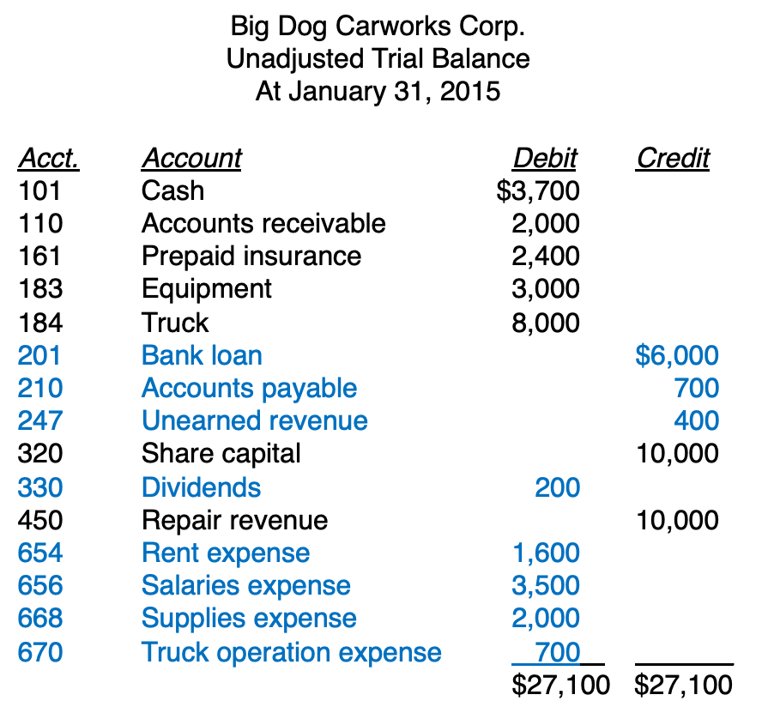
The Accounting Cycle: Review
Notes:
Textbook chapter 5; figure 5.14

Slide 57
Big Dog Carworks Corp.
Unadjusted Trial Balance
At January 31, 2015
Acct. Account Debit Credit 101 Cash $3,700
Accounts receivable 2,000
161 Prepaid insurance 2,400
183 Equipment 3,000
Truck 8,000
201 Bank loan $6,000
210 Accounts payable 700
247 Unearned revenue 400
320 Share capital 10,000
330 Dividends 200
450 Repair revenue 10,000
654 Rent expense 1,600
656 Salaries expense 3,500
668 Supplies expense 2,000
670 Truck operation expense 700
$27,100 $27,100
Big Dog Carworks Corp.
Adjusted Trial Balance
At January 31, 2015
Notes:
No need to know the details
But be sure to understand the principles

Slide 58
Big Dog Carworks Corp.
Unadjusted Trial Balance
At January 31, 2015
Acct. Account Debit Credit 101 Cash $3,700
Accounts receivable 2,000
161 Prepaid insurance 2,400
183 Equipment 3,000
Truck 8,000
201 Bank loan $6,000
210 Accounts payable 700
247 Unearned revenue 400
320 Share capital 10,000
330 Dividends 200
450 Repair revenue 10,000
654 Rent expense 1,600
656 Salaries expense 3,500
668 Supplies expense 2,000
670 Truck operation expense 700
$27,100 $27,100
Big Dog Carworks Corp.
Adjusted Trial Balance
At January 31, 2015
Notes:
No need to know the details
But be sure to understand the principles

Slide 59
Big Dog Carworks Corp.
Unadjusted Trial Balance
At January 31, 2015
Acct. Account Debit Credit 101 Cash $3,700
Accounts receivable 2,000
161 Prepaid insurance 2,400
183 Equipment 3,000
Truck 8,000
201 Bank loan $6,000
210 Accounts payable 700
247 Unearned revenue 400
320 Share capital 10,000
330 Dividends 200
450 Repair revenue 10,000
654 Rent expense 1,600
656 Salaries expense 3,500
668 Supplies expense 2,000
670 Truck operation expense 700
$27,100 $27,100
Big Dog Carworks Corp.
Adjusted Trial Balance
At January 31, 2015
Notes:
No need to know the details
But be sure to understand the principles

Slide 60
Big Dog Carworks Corp.
Unadjusted Trial Balance
At January 31, 2015
Acct. Account Debit Credit 101 Cash $3,700
Accounts receivable 2,000
161 Prepaid insurance 2,400
183 Equipment 3,000
Truck 8,000
201 Bank loan $6,000
210 Accounts payable 700
247 Unearned revenue 400
320 Share capital 10,000
330 Dividends 200
450 Repair revenue 10,000
654 Rent expense 1,600
656 Salaries expense 3,500
668 Supplies expense 2,000
670 Truck operation expense 700
$27,100 $27,100
Big Dog Carworks Corp.
Adjusted Trial Balance
At January 31, 2015
Notes:
No need to know the details
But be sure to understand the principles

Slide 61
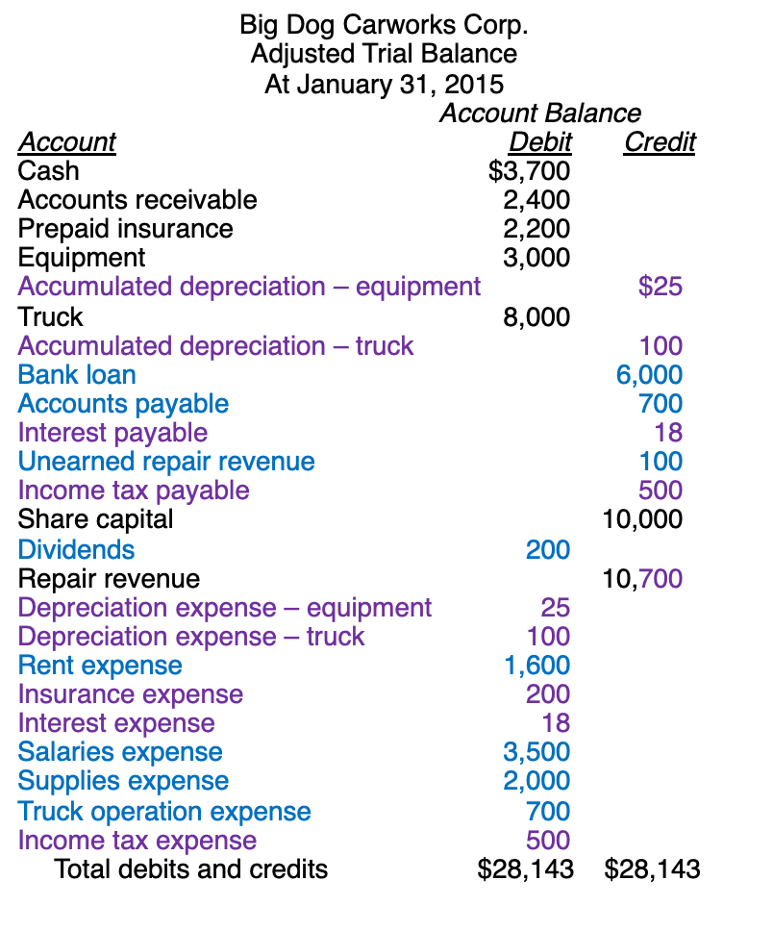

The Accounting Cycle: Review

Slide 62
The Accounting Cycle
Adjustment: in addition to depreciation of fixed assets, there are four other types of adjustment entries needed:
Deferred expenses (Prepaid ~; = ___________)
Assets paid for before their use. When they are used, this asset’s value is reduced and an expense is recognized. Some examples include supplies, insurance, and depreciation.
Deferred revenues (unearned ~; = ___________)
Customer advanced payments for product or services yet to be provided. When the company provides the product or service, revenue is then recognized.
Accrued revenues
Revenues earned in a period but have yet to be recorded and no money has been collected. Accrued revenues are updated at the end of the period to recognize revenue and money owed to the company.
Accrued expenses
Accrued expenses are incurred in a period but have yet to be recorded and no money has been paid. Accrued expenses are updated to reflect the expense and the company’s liability.

Slide 63
Adjusted Trial Balance at the End of of a Reporting Period
Notes:
PDF, p109

Slide 64
1
1
2
2b

Slide 65
1
1
2
2b
2a

Slide 66
3
3a
3b
Notes:
PDF, p111

Slide 67
Adjusted Trial Balance at the End of of a Reporting Period
Notes:
PDF, p109

Slide 68
Adjusted Trial Balance at the End of of a Reporting Period
___________
_____________________________
3
_______________________
__________________
____________________________
2
1
____________________.

Slide 69
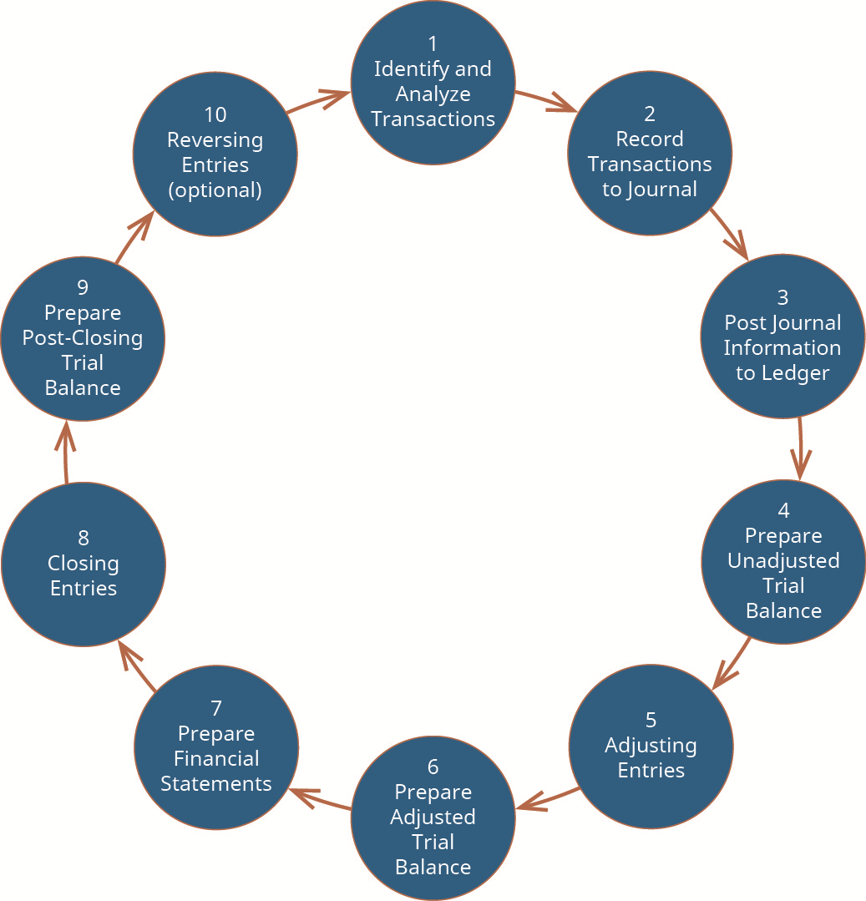

Slide 71
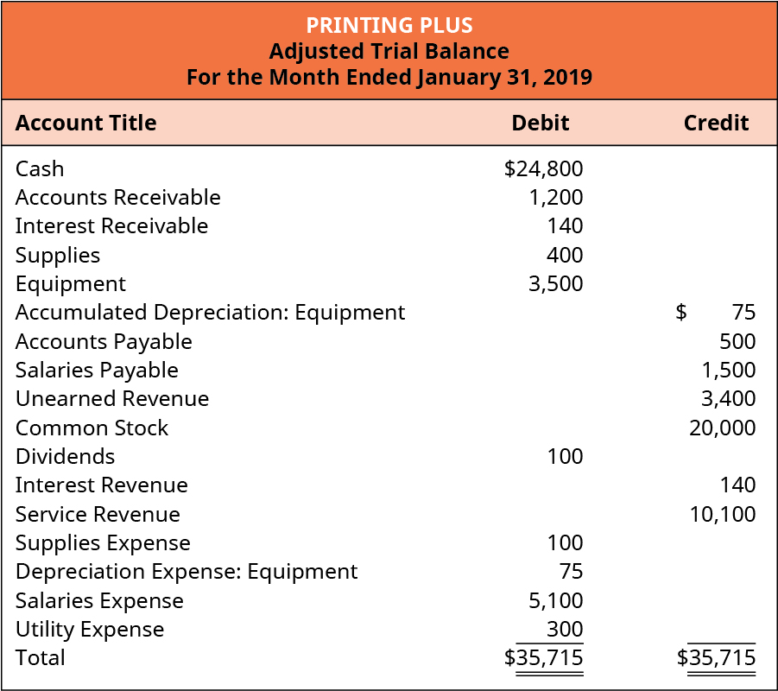
The Accounting Cycle:
Step 8. Closing Entries
Closing entry 1: DR CR
Closing entry 2: DR CR
Closing entry 3: DR CR
Closing entry 4: DR CR

Slide 72
The Accounting Cycle:
Step 8. Closing Entries

Slide 73
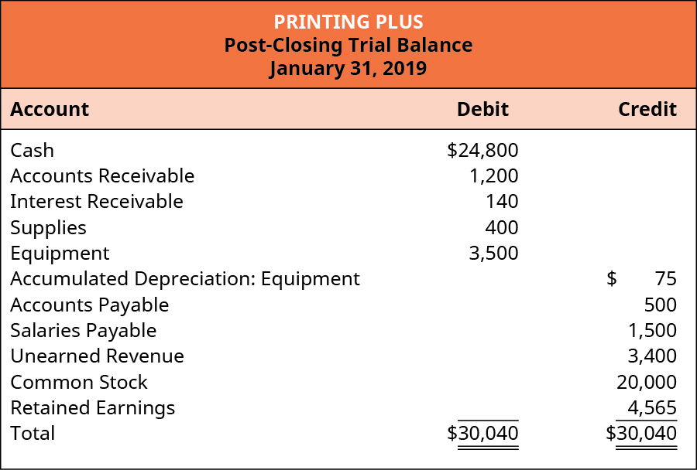
Steps 9 – Prepare Post-Closing Trial Balance

Slide 74
Summary
The adjusted trial balance is used to prepare financial statements.
Income Statement is first prepared
The income statement shows the net income or loss as a result of revenue and expense activities occurring in a period.
Net income (or loss) from the income statement is used to prepare the RE part of the Statement of Owners’ Equity.
The statement of retained earnings shows the effects of net income (loss) and dividends on the earnings the company maintains.
Once the equity accounts are updated, together with the ledger balances of assets and liabilities from the adjusted trial balance, the Balance Sheet is prepared.
The balance sheet visually represents the accounting equation, showing that assets balance with liabilities and equity.
Notes:
Ref. book, p273

Slide 75
Thank you!
Questions?

